Slide 1
ICTC6212 POE Touchpoint 1
Breakdown of Activity 1 - 3

Slide 2
Activity 1: Unpacking TPACK

Slide 3
ACTIVITY 1.1
Explain how TPACK works by providing a definition and examples.
Note:
Explain all three components: Pedagogical Knowledge, Technological Knowledge, Content Knowledge and the intersections between these three types of knowledge.
Show evidence of research. This means citing multiple reliable sources.
Demonstrate understanding with examples.

Slide 4
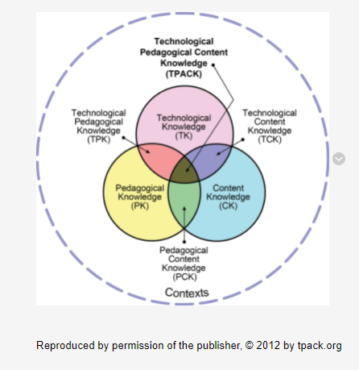
Activity 1.1 Checklist
Explained Technological Knowledge (TK)
Provided an example of TK
Explained Content Knowledge (CK)
Provided an example of CK
Explained Pedagogical Knowledge (PK)
Provided an example of PK

Slide 5
ACTIVITY 1.2
Use SmartArt or diagramming tool to create your own TPACK model for the lesson topic of your choice.
TOPIC
The lesson topic outcomes from CAPS document.
LEARNING OUTCOMES
LO1 | LO2 | LO3
Name and describe at least three tools (apps) used to teach the content.
TOOLS
Tech Tool 1 | Tech Tool 2 | Tech Tool 3
Diagram must contain all information, show intersections and must be clearly labelled.
TK: Describe what technological knowledge would be required to achieve the lesson outcomes.
TK
PK: Describe the choice of pedagogy (i.e., pedagogical knowledge) and how you would help learner achieve the lesson outcomes.
TPK
TCK
TPACK
CK: Describe the content knowledge required.
PK
PCK
CK
Total marks: 15

Slide 6
Activity 1.2 Checklist
Provided lesson topic outcomes from CAPS doc
Named + described 2 tech tools
Created the TPACK diagram using shapes or SmartArt
The diagram has clear labels
Shows the intersections (TPK, PCK, TCK, TPACK)
Describes the technological knowledge required
Describes the content knowledge required
Describes the choice of pedagogy

Slide 7
Activity 2: Evaluating Software

Slide 8
9 marks per tool, 18 marks total
ACTIVITY 2
PART 1
Consider the three tools chosen in Activity 1 and evaluate two of them by comparing the table below.
Refer to Table 6.2 on page 177
1. | What are the objectives of the software?
a) b) c) d) e) | What does the software aim to help learners achieve? What kinds of features are available? (For example, is there a feedback function? Are the instructions clear? Is there a ‘Help’ option?) Does the software provide supplementary exercises that learners can cover without the aid of the teacher? In other words, is the software teacher-driven or can it be used in the absence of a teacher? Does the package offer additional examples of content work that cannot be covered adequately in class time? Does it free up class time by providing extra practice outside class time so that the teacher can cover new information?
2. | Is the software accessible?
a) b) c) | Can teachers and learners use the software with ease? Is there a comprehensive instructional manual? Can learners progress easily from one lesson to the next and save completed work? Can learners exit from any point and save their work?
3. | How does the software evaluate learners’ answers?
a) b) | Does the package provide learners with extensive feedback after each response? Does the feedback clearly illustrate the process required to solve the problem?
Source: Hardman, 2008: 177

Slide 9
ACTIVITY 2
Consider the three tools chosen in Activity 1 and evaluate two of them by comparing the table below.
Refer to Table 6.2 on page 177
4. | Does the software’s design support learning?
a) | Does the software offer exercises that can adjusted according to these learner variables: age, gender, home language, specific learning needs, deductive or inductive reasoning, field-dependent or –independent reasoning, and visual, auditory and kinesthetic learning styles?
5. | How are the exercises arranged?
a) b) | Are the exercises designed on a progressing scale of difficulty? Are the exercises grouped according to curriculum topic areas?
6. | Does the program focus on cognitive levels in the exercises?
a) | For example, does the program focus on recognition, recall, comprehension, experiential learning and constructive understanding (using the computer to construct knowledge)?
7. | Does the program provide opportunities for pair work, group work and individual work?
8. | Does the program track learners’ scores?
a) b) | Does the teacher have access to these scores? Does the program record the number of times each learner attempts to answer a question as well as the number of right and wrong answers?
Source: Hardman, 2008: 177

Slide 10
ACTIVITY 2
Consider the three tools chosen in Activity 1 and evaluate two of them by comparing the table below.
Refer to Table 6.2 on page 177
9. | What kind of activities does the software provide?
a) | Is there a range of activities, such as quizzes, games, tests, simulations, tutorials, drill-and-practice exercises, problem solving and exploratory activities?
Source: Hardman, 2008: 177
PART 2
Decide which of the two software tools/apps will be best suited to achieve your learning outcomes + justify your choice in 200 words or less (2 marks).
You must justify with reference to the lesson outcomes and results of evaluation.
Total marks: 20

Slide 11
Example of a Software Evaluation

Slide 12
1. | What are the objectives of the software?
To make any video a lesson: teachers can choose a video, adapt it by embedding questions and audio, and track students’ comprehension. Reinforce accountability: teachers can check if students are watching the videos, how many times they’re watching each section, and if they understand the content. Engage students: Edpuzzle introduces students to self-paced learning with interactive videos with voice narration and questions. Saves time: Teachers can quickly create interactive video lessons with existing YouTube videos. Edpuzzle can help free up class time as students can work through the video lessons at home.
2. | Is the software accessible?
Cost: Basic plans are free for teachers and students. Sign up and login is quick and easy. Ease of use: Edpuzzle is very easy for teachers to use as they can create video lessons in three easy steps. It is also easy for learners to use. The questions pop up automatically as the video plays and are either MCQ or open-ended. Once the student completes the question the video continues to plan. Learners they can pause at any point and rewatch small sections or the entire video if they need. | Can teachers and learners use the software with ease? Is there a comprehensive instructional manual? Can learners progress easily from one lesson to the next and save completed work? Can learners exit from any point and save their work?
3. | How does the software evaluate learners’ answers?
Gradebook: Edpuzzle has a comprehensive “Gradebook” that contains detailed analytics, such as progression calculations, total score, total time spent, and individual student reports. Feedback: Teachers can add personalized feedback by commenting on a student’s response to clarify information or provide helpful tips and encouragement. | Does the package provide learners with extensive feedback after each response? Does the feedback clearly illustrate the process required to solve the problem?

Slide 13
4. | Does the software’s design support learning?
Learning Styles: Edpuzzle accommodates visual learners (with video), auditory learners (with narration) and kinesthetic learners (with the embedded questions). Different learning abilities: Edpuzzle is self-paced so students with different abilities can work at their own pace. For example, slower learners can pause and rewatch sections. For faster learners, you can add links to interesting websites or attach PDF with additional supplementary information that goes beyond the curriculum. | Visual
5. | How are the exercises arranged?
Questions are embedded into a video. The videos are on a relevant topic and the embedded questions would relate to that topic as it is explained or discussed throughout the video.
6. | Does the program focus on cognitive levels in the exercises?
The MCQ questions focus primarily on recall and comprehension, they are testing the students’ understanding of the content or concepts as they are taught. The open-ended questions may allow for a more thoughtful response that could be linked to higher-order thinking skills and the construction of knowledge. | For example, does the program focus on recognition, recall, comprehension, experiential learning and constructive understanding (using the computer to construct knowledge)?

Slide 14
7. | Does the program provide opportunities for pair work, group work and individual work?
Edpuzzle is best suited to individual or pair work.
9. | Does the program track learners’ scores?
Teachers are able to monitor their learners’ progress, responses and grades. | Does it keep track of the total time each learner spends on an exercise? Does it chart the progress of learners?
10. | What kind of activities does the software provide?
In Edpuzzle you are able to add open-ended questions and multiple-choice questions. The type of activity will depend largely on the video selected. The questions that one embeds in a video could be seen as a knowledge check quiz, questions relating to a simulation or tutorial or a drill-and-practice type of exercise. | Does it keep track of the total time each learner spends on an exercise? Does it chart the progress of learners?

Slide 15
Activity 3: The Lesson Plan in a South African Context

Slide 16
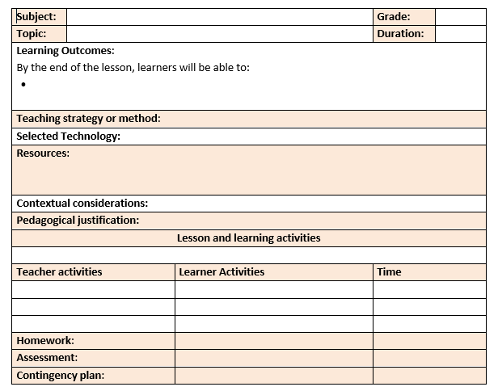
Please make sure you’re using the correct template.
Find the template in More Resources > POE Resources > POE Lesson Plan Template

Slide 17
ACTIVITY 3

Slide 18
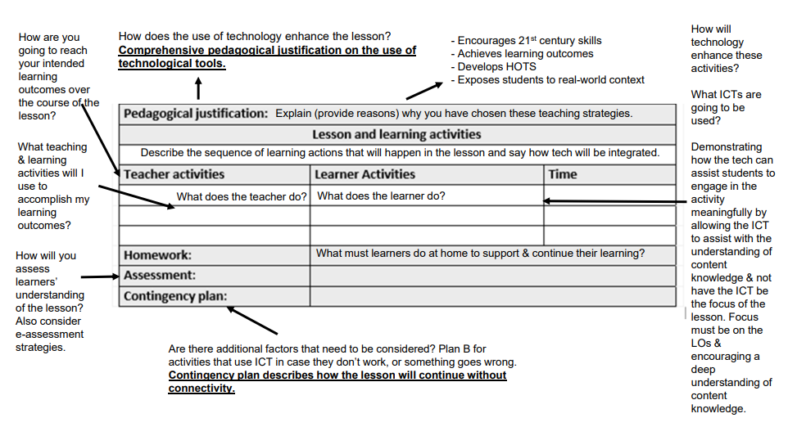
ACTIVITY 3

Slide 19
Activity 3 Checklist
Subject, Topic, Grade and Learning Outcomes match CAPS requirements.
Comprehensive summary of the teaching strategy/method.
Comprehensive list of resources required to achieve LOs
Contextual consideration describes how technology achieved the LOs
Comprehensive pedagogical justification on the use of tech tools.
A min of 5 teacher & learner activities that include ICT integration in at least 3 activities.
Homework includes tech tools to achieve LOs.
Assessment describes the marking process.
Contingency plan describes how the lesson will continue without connectivity.

