Slide 1
Activity 4: Designing assessments for your lesson

Slide 2
Activity 4.1 Develop diagnostic & formative assessment
Develop a diagnostic assessment of 3 – 5 questions to test your learner’s prior knowledge, using any software app (i.e., Kahoot, Google Froms).
A diagnostic assessment is concerned with finding out what learners know about a specific subject prior to instruction in the subject (to assist lesson planning).
Develop a formative assessment of 5 – 10 questions to test learner’s progress.
In a formative assessment the goal is for the teacher to see how learners are progressing while teaching in a specific subject is ongoing.
In your word document write out the questions, answers and feedback.
Copy and paste a weblink to the test.

Slide 3
Activity 4.1 Checklist
Diagnostic Assessment
Developed a diagnostic assessment of 3 – 5 questions using an appropriate software app
Questions are designed to measure prior knowledge
Questions, answers and feedback are typed out in your Word document
Weblink to assessment is added to Word doc
Formative Assessment
Developed a formative assessment of 5 – 10 questions using an appropriate software app
Questions are designed to test progress
Questions, answers and feedback are typed out in your Word document
Weblink to assessment is added to Word doc

Slide 4
Example of Activity 4.1
Question 1:
Question: Technological knowledge (TK) is _______ .
Answer: An understanding of the relevant technology at one’s disposal.
Feedback: Correct, this also includes the skills to operate technologies and the ability to learn and adapt to new technologies.
Question 2:
Question: Technological pedagogical knowledge (TPK) is the knowledge of _______.
Answer: How technology transforms & enhances teaching.
Feedback: Correct, TPK is the knowing about different technologies and how they are used in teaching and learning.
Question 3:
Question: Technological content knowledge (TCK) is the knowledge of _______.
Answer: How technology is used in a subject area for deep & lasting learning.
Feedback: Correct, TCK is knowledge about the way the subject matter can be changed by the application of technology.
Question 4:
Question: Koehler & Mishra built on Schulman’s PCK model to develop the TPACK model in 2006.
Answer: True
Feedback: Koehler & Mishra built on Schulman’s PCK model to show that 21st century teaching is a highly complex activity that embraces many kinds of knowledge.
Weblink to assessment: https://create.kahoot.it/share/tpack-quiz/afb95588-26fd-4049-ba70-4b85434ad4c3

Slide 5
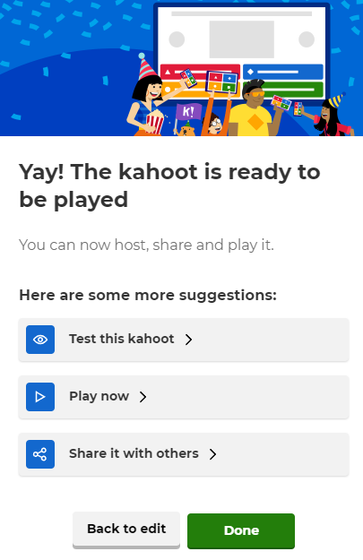
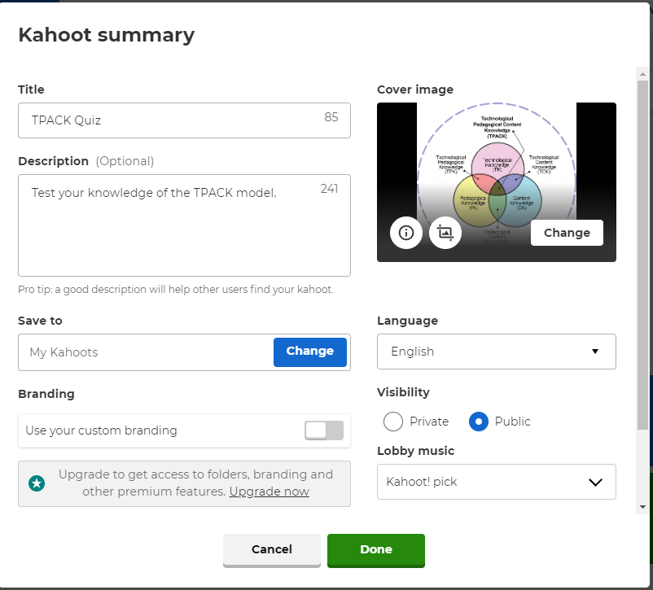
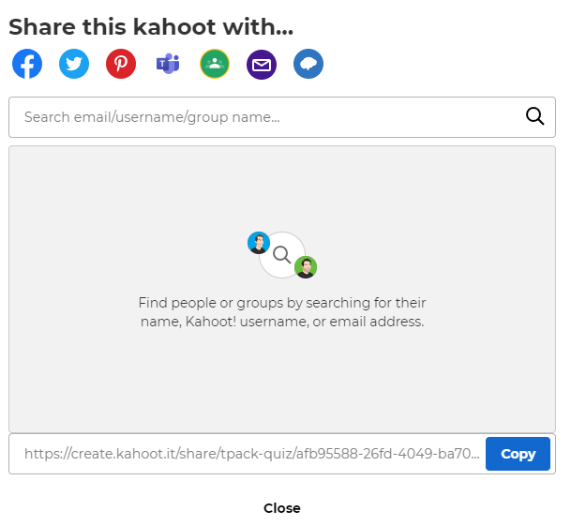
If you use Kahoot! you need to make sure that it’s set to PUBLIC. Go to ‘Settings’ and under ‘Visibility’ select ‘Public’.
Then you are able to ‘Share it with others’ and copy the weblink.

Slide 6
Activity 4.2 Assessment reviewed and evidence provided
Test your diagnostic assessment and your formative assessment
Go to your quiz & answer the questions as if you were a student
Take a screenshot of the test questions & your answers

Slide 7
Activity 4.2 Checklist
Diagnostic assessment tested & screenshots provided as evidence for each question
Formative assessment tested and screenshots provided as evidence for each question
Screenshots are neatly & orderly pasted in your Word document under the Activity 4.2 heading

Slide 8
Example of Activity 4.2

Slide 9
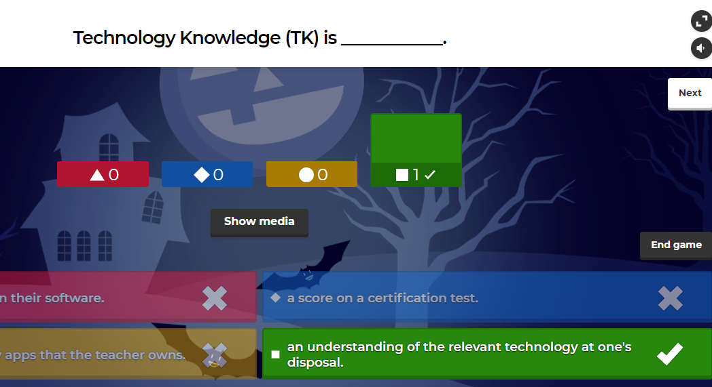
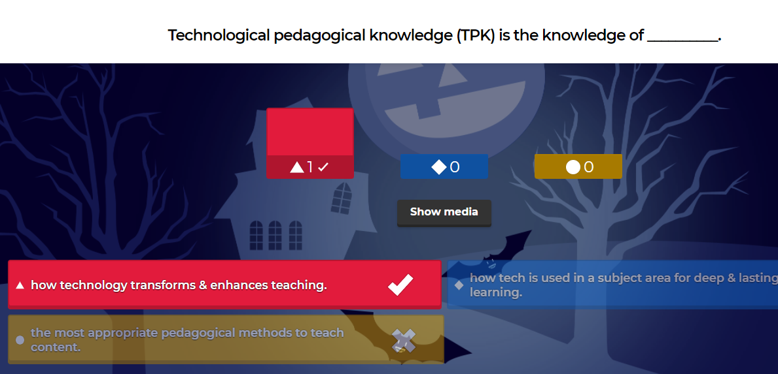

Slide 10
Activity 4.3 Critical Evaluation of Assessments
Critique your assessments (both) from the perspective of a peer reviewer. Answer the following questions:
Do the assessments match their purpose?
Does the diagnostic assessment test learners’ prior knowledge?
Does the formative assessment test learners’ progress?
Do the assessments achieve the learning outcomes?
What are the strengths and weaknesses of the two assessments?
What changes or improvements could be made to each assessment?

Slide 11
Activity 4.3 Checklist
Evaluation looks at whether the assessment achieves its purpose
Evaluation looks at whether learning outcomes are met
Evaluation discusses assessment strengths and weaknesses
Evaluation provides suggested changes to assessment questions
Evaluation is between 400 and 550 words

Slide 12
Activity 5: Evaluating Affordances and Constraints for ICT Integration

Slide 13
Activity 5 Evaluating affordance & constraints for ICT integration
0 | 1 | 2 | 3 | 4
None | Extremely Restricted | Restricted | Mostly Restricted | Unrestricted
School: Lesson to present: |  | Level of integration score | Details
School | Electricity supply
 | Internet connectivity
 | Device access
 | Policy
Commu | Electricity supply
 | Internet connectivity
 | Device access
Integration Strategy and reflection
Evaluate the ICT integration in a school that you are familiar with (i.e., from your TE)
Level of integration score: rate the level of integration on a scale of 0 - 4
Details: provide details on the level of integration for each of the factors
Integration strategy & reflection:
Discuss whether you can present your lesson as planned in Activity 3 without any changes & why.
Describe the changes you will need to make considering the level of ICT integration at the school you have evaluated

Slide 14
Activity 5: Checklist
Provided the name of school (from TE)
Table completed in full
The school has been scored for each factor and details provided
The community has been scored for each factor and details provided
Scores match TE placement
Integration strategy and reflection correctly reflects whether the lesson can proceed unchanged or which changes need to be made based on the level of integration scores

